Slide 1

Music, Genre and Origin
Niti Mishra
Miquel Torrens
Bálint Ván

Slide 2
Framework
Define Objectives
Dataset we are using

Slide 3
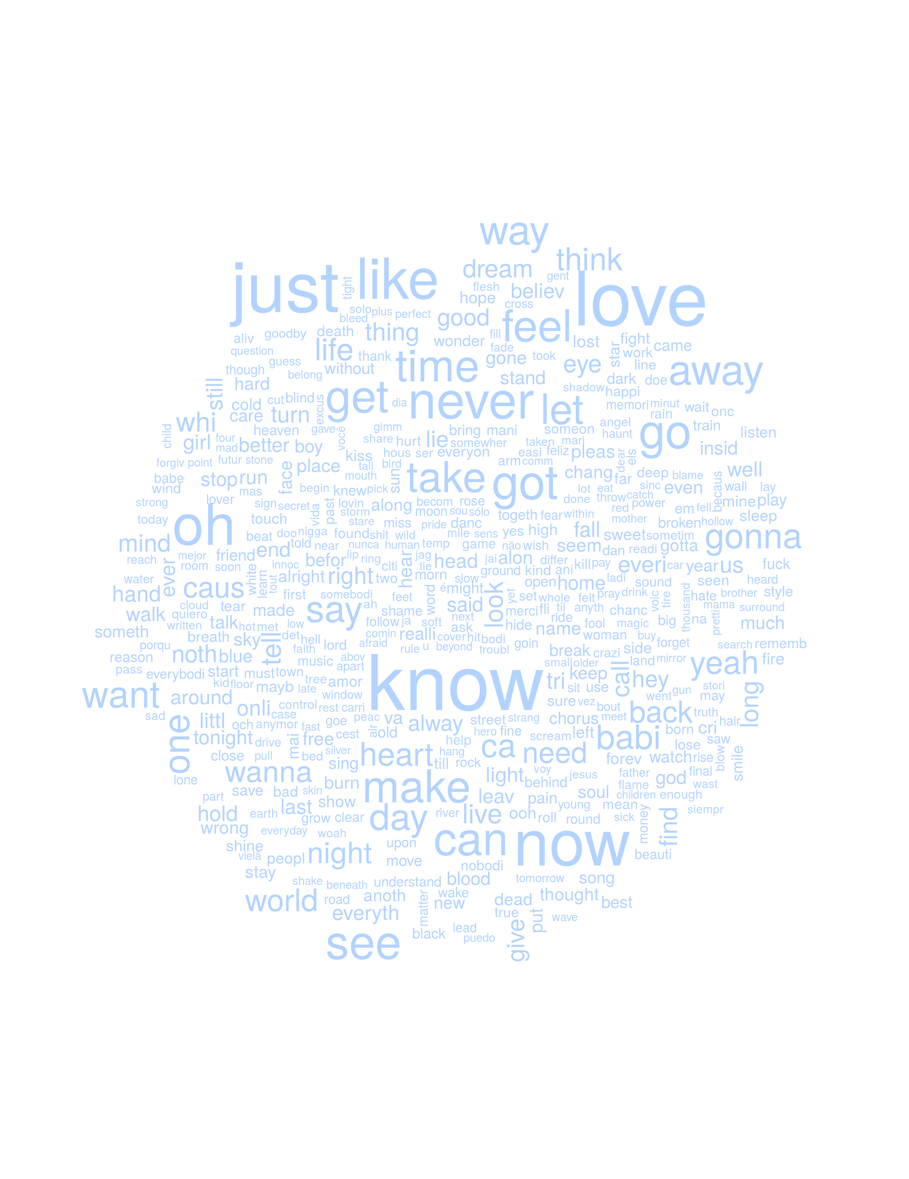
Data
Musical Summary Variables
Metadata
Song Terms
Usage Data
Lyrics Data

Slide 4
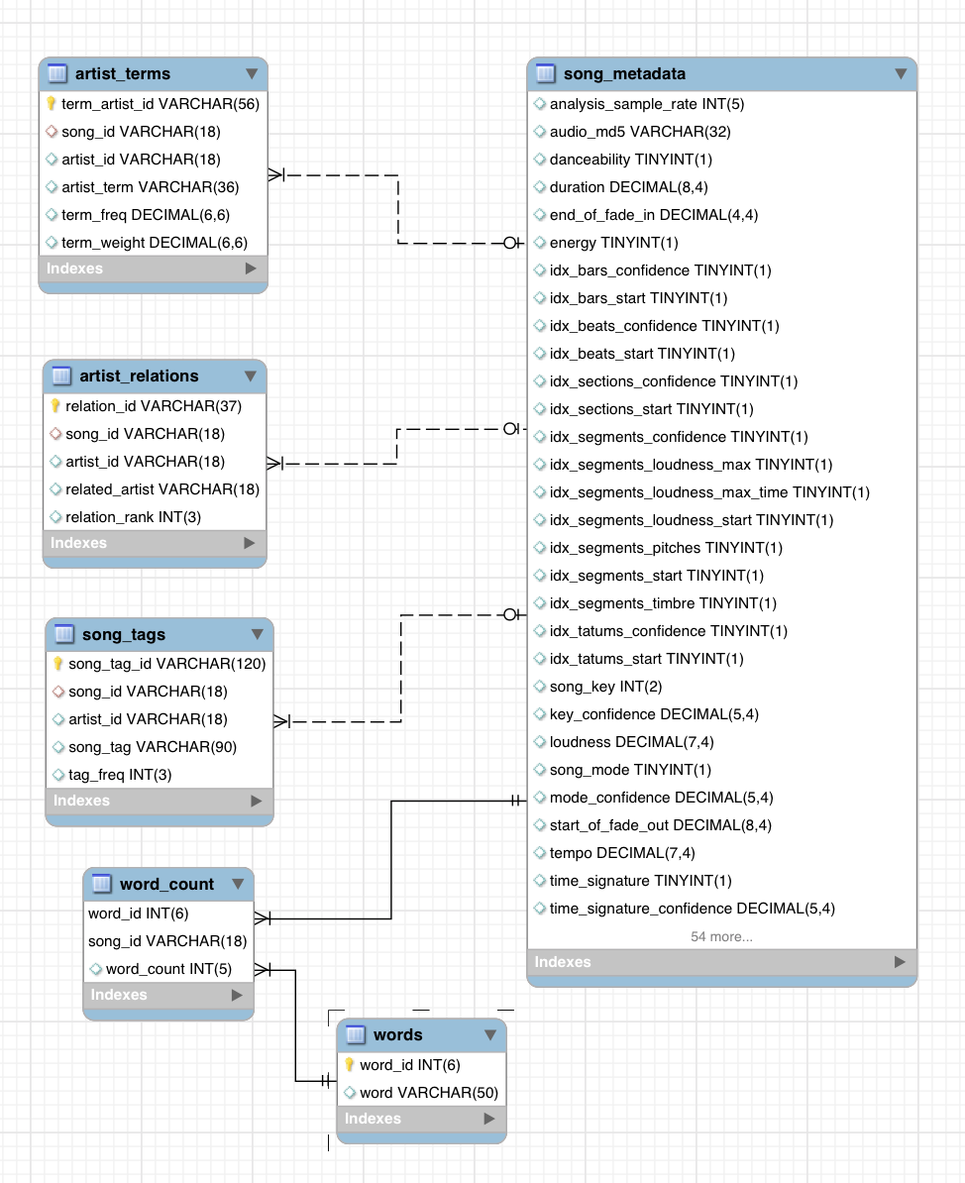
Data Cleaning & Storage
Raw Hierarchical Data
Unstructured texts
Location data via Google APIs
MySQL data storage

Slide 5
Analysis
Genre Evolution
Time Evolution
Dataset we are using

Slide 6
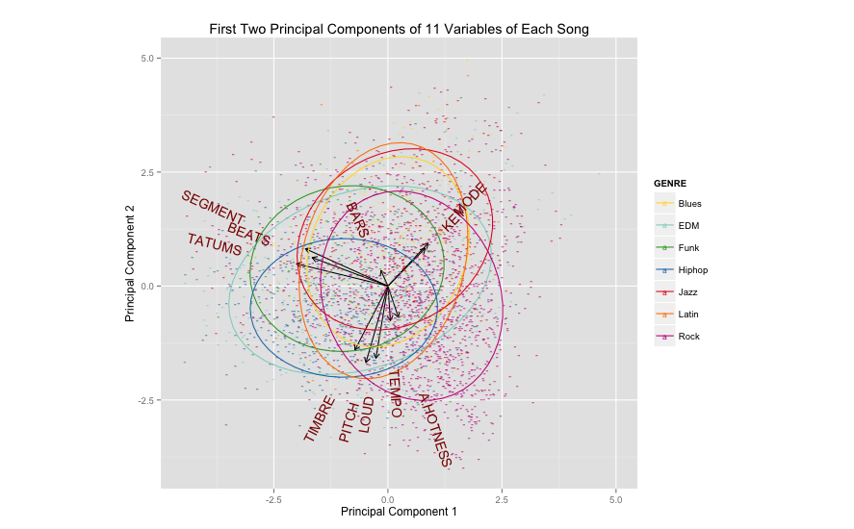
How Do Music Genres Differ?

Slide 7
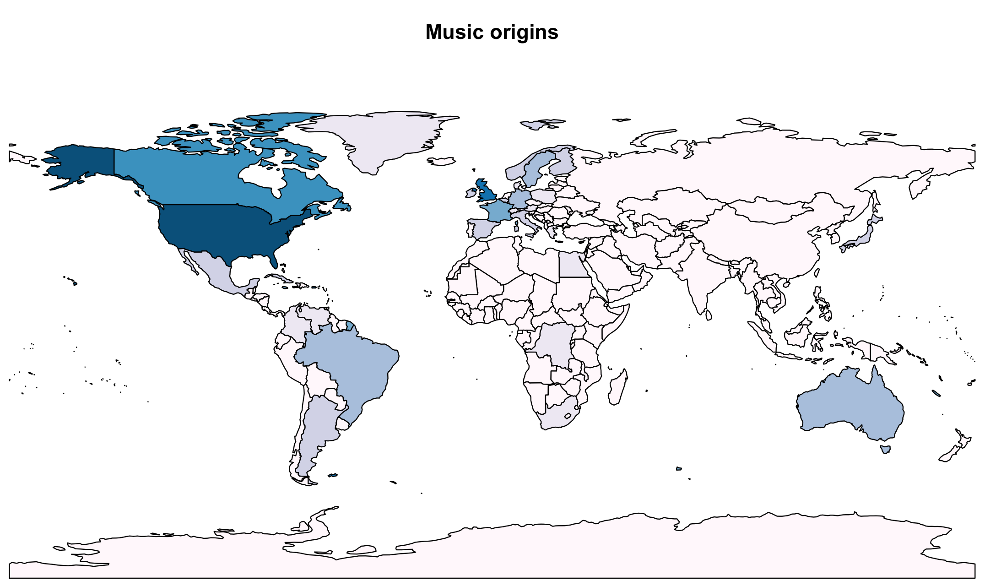
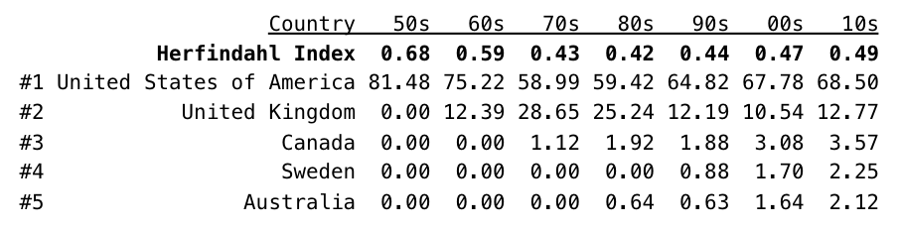
Exploring the Origins

Slide 8
Recommender System
Based on Mahalanobis distance of technical features
Preselection of bands according to usage data
Chooses the closest songs of 3rd artists

Slide 9
Recommender System: Ex. 1
SONG: “Poker Face” by Lady Gaga
“Music of the Sun” – Rihanna
“Marseille” – Thomas Dolby
“Single Ladies” – Beyoncé
“Krazy in Luv” – Beyoncé
“Good Girl Gone Bad” – Rihanna

Slide 10
Recommender System: Ex. 2
SONG: “Polly” by Nirvana
“You” – Radiohead
“Still” – Foo Fighters
“Everything In Its Right Place” – Radiohead
“I Know Somethin (Bout You)” – Alice In Chains
“Naked in the Rain” – Red Hot Chili Peppers

Slide 11
Findings & Conclusions
GENRE DIFFERENCES | Yes! We can spot and measure the differences
TIME EVOLUTION | Not much…
POPULARITY | Few aspects of the composition of the song do affect popularity, but e.g. not genre
WORLD PRODUCTION | Concentration in US and UK, on the rise again
RECOMMENDER SYSTEM | Similar tastes leads to similar songs

Slide 12



